Slide 1
Week 10_Lec 2
Link State OSPF

Slide 2
OSPF (Open Shortest Path First) routing
“open”: publicly available
classic link-state
each router floods OSPF link-state advertisements (directly over IP rather than using TCP/UDP) to all other routers in entire AS
multiple link costs metrics possible: bandwidth, delay
each router has full topology, uses Dijkstra’s algorithm to compute forwarding table
security: all OSPF messages authenticated (to prevent malicious intrusion)

Slide 3
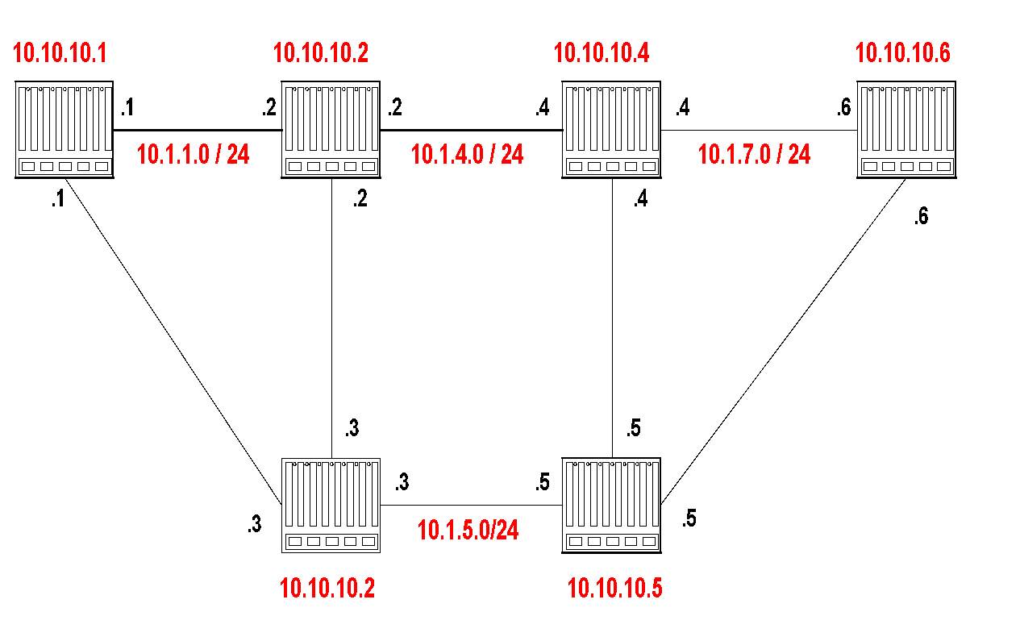
Example Network
Router IDs are selected independent of interface addresses
Link costs are called Metric
Metric is in the range [0 , 2¹⁶]
Metric can be asymmetric

Slide 4
Link state Advertisements
The LSA of router 10.10.10.1 is as follows:
Link State ID: 10.10.10.1 = can be Router ID
Advertising Router: 10.10.10.1 = Router ID
Number of links: 3 = 2 links plus router itself
Description of Link 1: Link ID = 10.1.1.1, Metric = 4
Description of Link 2: Link ID = 10.1.2.1, Metric = 3
Description of Link 3: Link ID = 10.10.10.1, Metric = 0

Slide 5
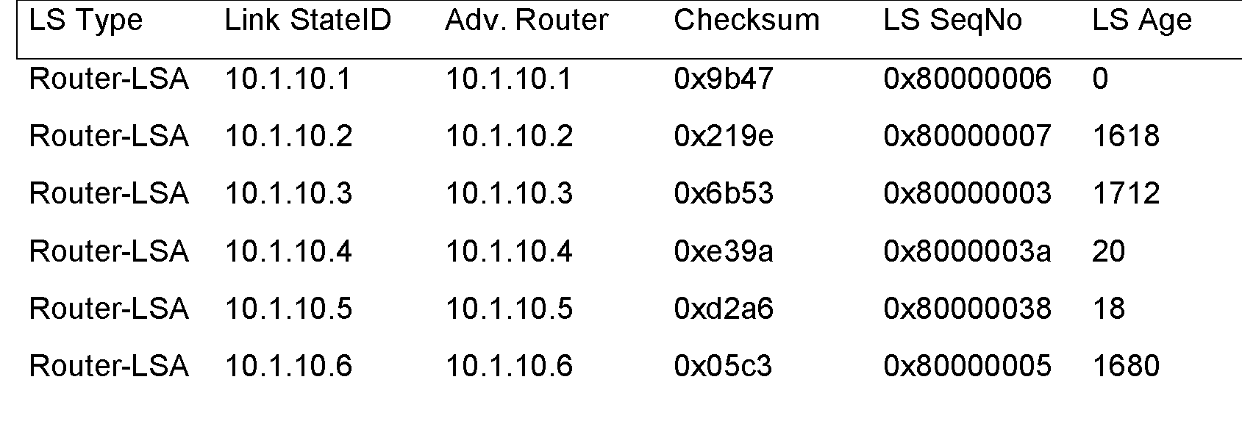
Link State Database
The collection of all LSAs is called the link-state database
Each router has an identical link-state database
Useful for debugging: Each router has a complete description of the network
If neighboring routers discover each other for the first time, they will exchange their link-state databases
The link-state databases are synchronized using reliable flooding

Slide 6
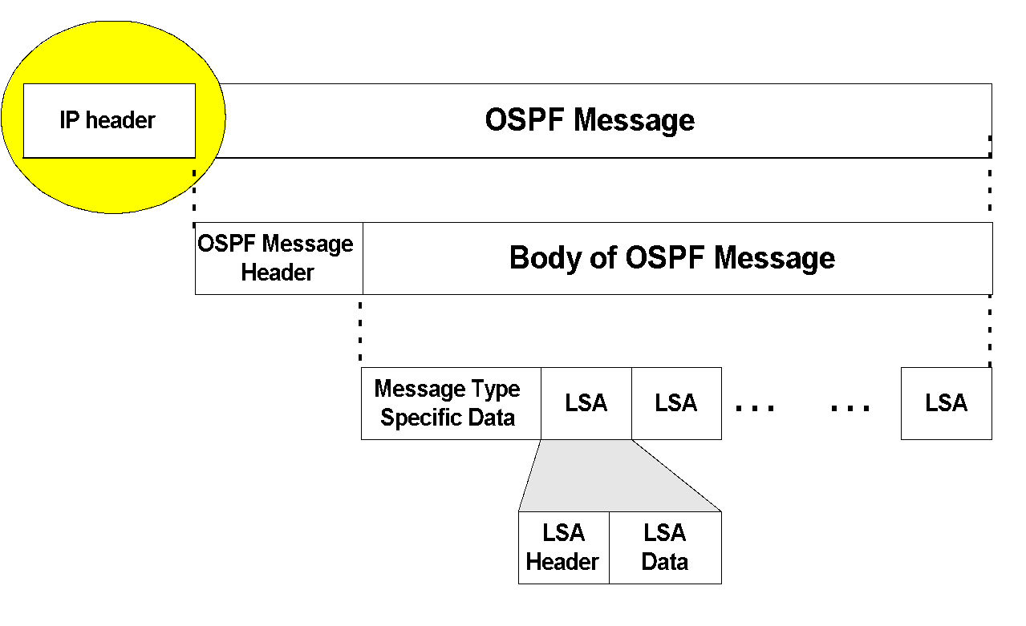
OSPF Packet format
OSPF packets are not carried as UDP payload!
OSPF has its own IP protocol number: 89
TTL: set to 1 (in most cases)
Destination IP: neighbor’s IP address or 224.0.0.5 (ALLSPFRouters) or 224.0.0.6 (AllDRouters)

Slide 7
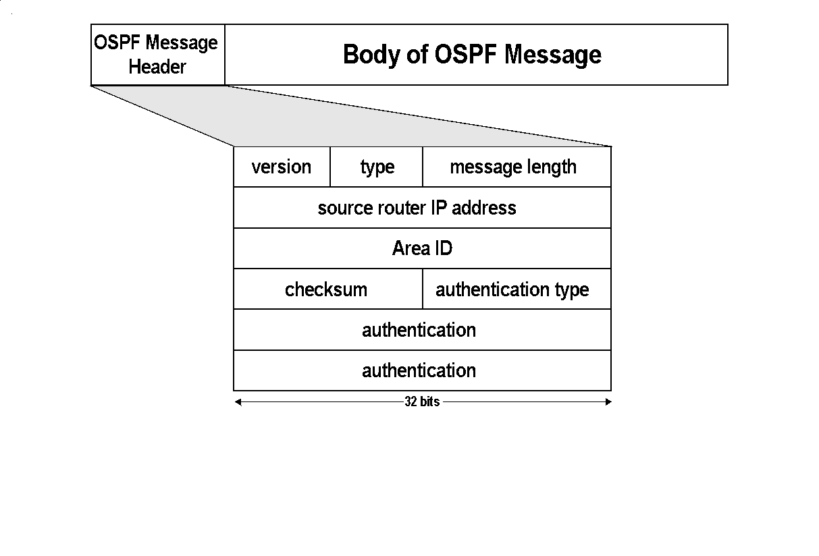
Message types:
1: Hello (tests reachability)
2: Database description
3: Link Status request
4: Link state update
5: Link state acknowledgement

Slide 8
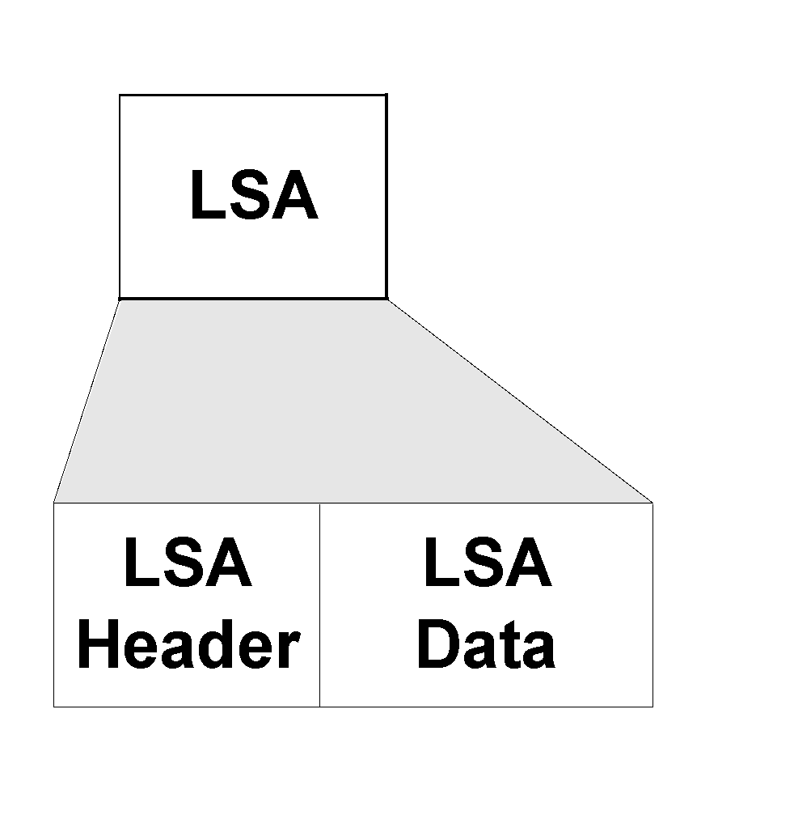
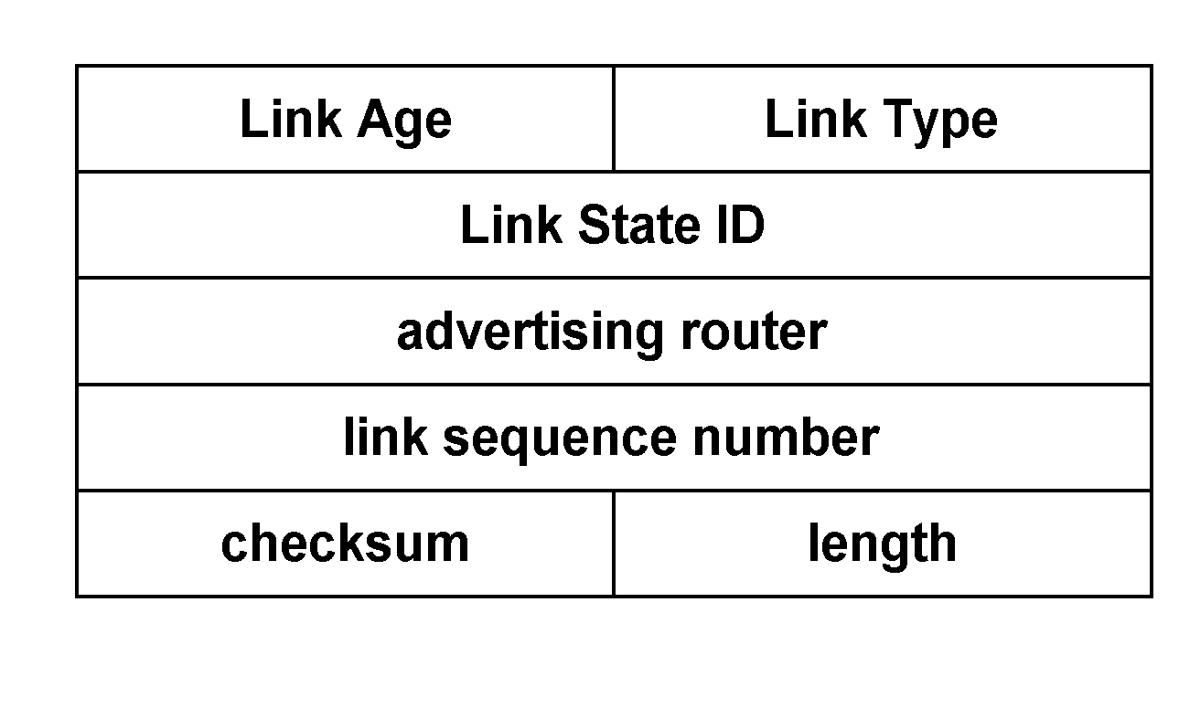
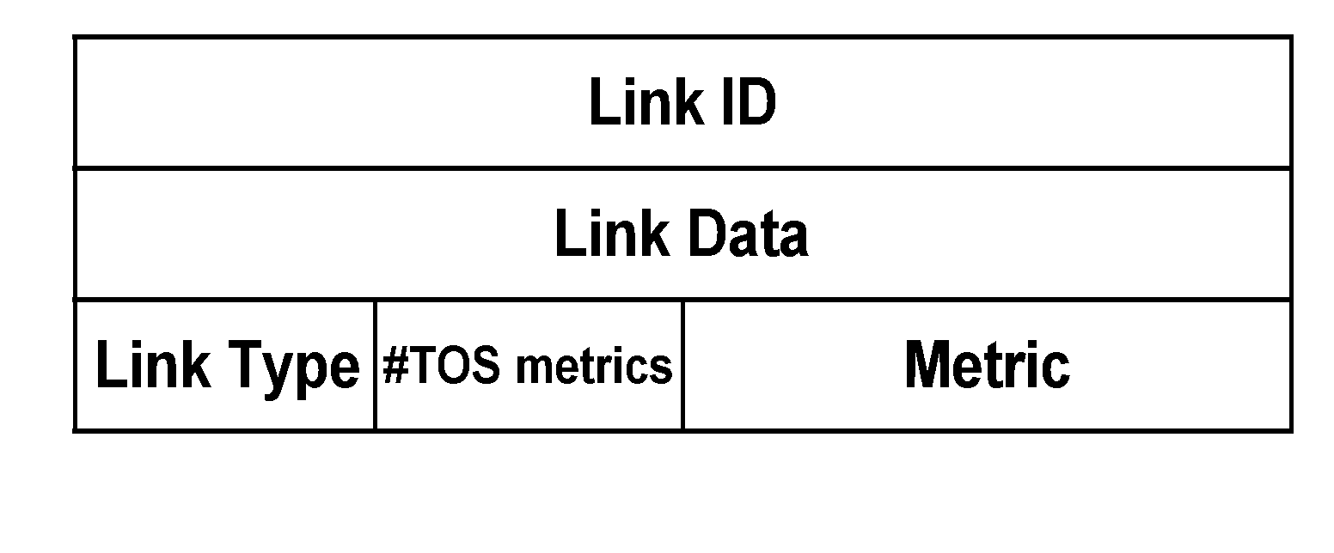
OSPF LSA format
LSA Header
Link 1
Link 2
LSA Header
Link 1
Link 2

Slide 9
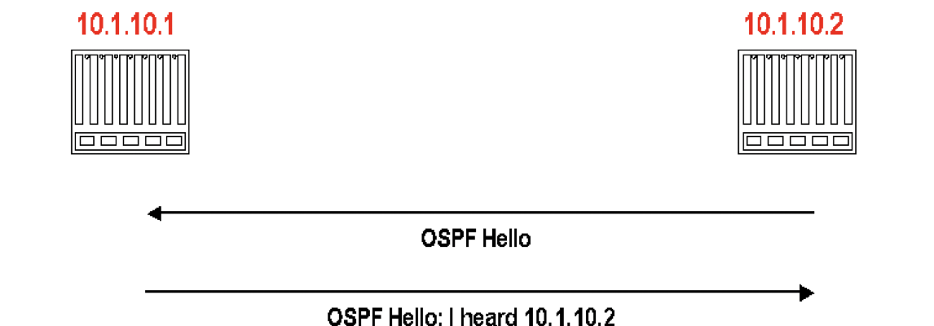
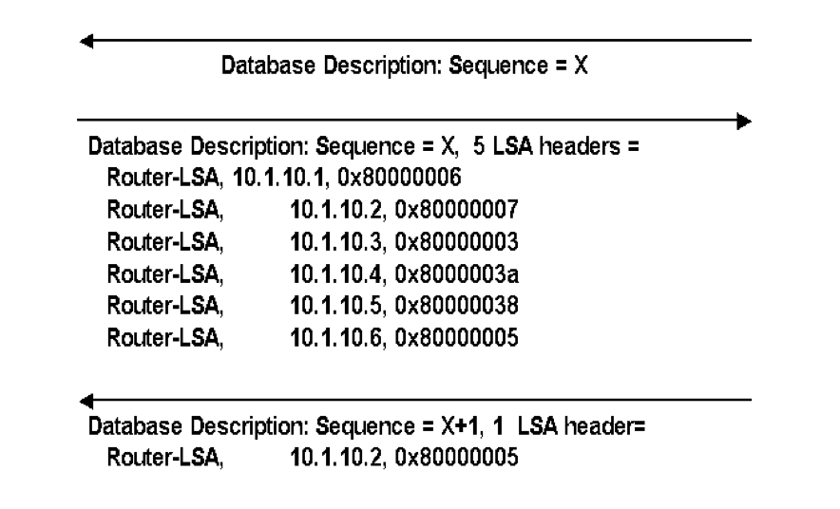

Discovery of adjacency
After neighbors are discovered the nodes exchange their databases
Sends database description. (description only contains LSA headers)
Database description of 10.1.10.2
Acknowledges receipt of description
Routers multicasts OSPF Hello packets on all OSPF-enabled interfaces.
If two routers share a link, they can become neighbors, and establish an adjacency
After becoming a neighbor, routers exchange their link state databases

Slide 10
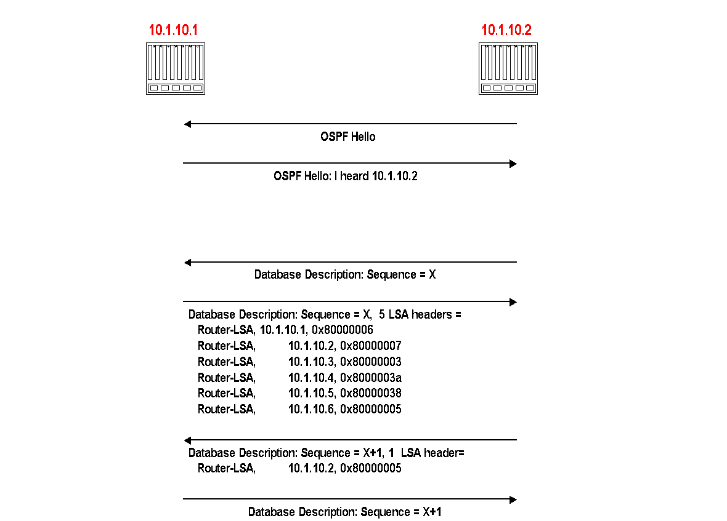

Slide 11
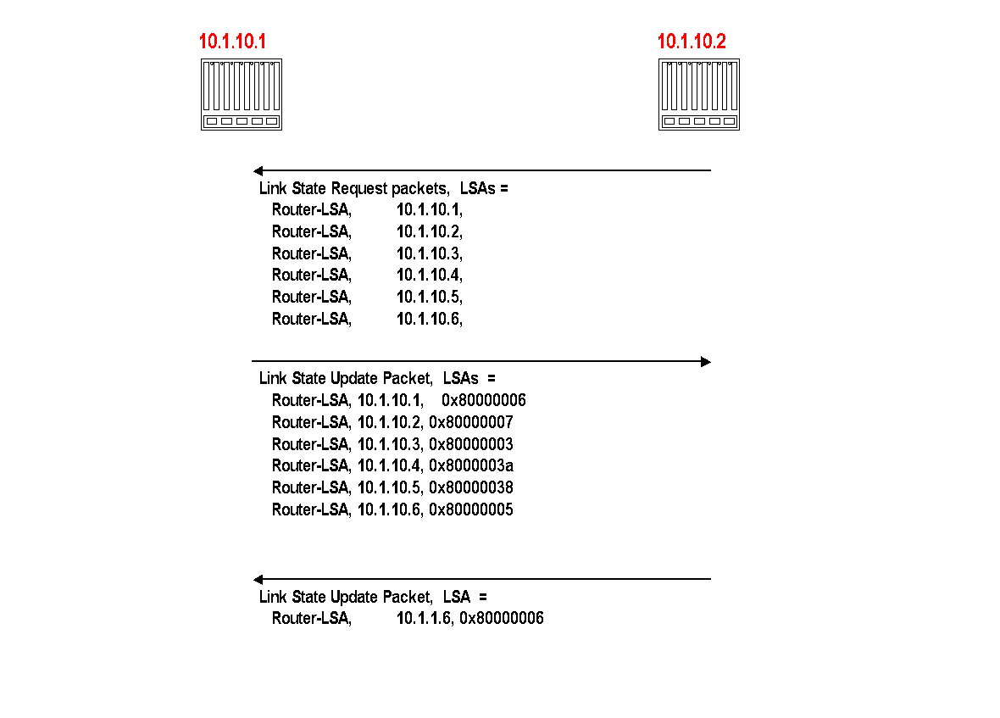
Regular LSA Exchanges
A router sends and refloods LSA-Updates, whenever the topology or link cost changes. (If a received LSA does not contain new information, the router will not flood the packet)
Exception: Infrequently (every 30 minutes), a router will flood LSAs even if there are no new changes.
Acknowledgements of LSA-updates:
explicit ACK, or
implicit via reception of an LSA-Update
10.1.10.2 explicitly requests each LSA from 10.1.10.1
10.1.10.2 has more recent value for 10.0.1.6 and sends it to 10.1.10.1 (with higher sequence number)

Slide 12
Dijkstra’s link-state routing algorithm
centralized: network topology, link costs known to all nodes
accomplished via “link state broadcast”
all nodes have same info
computes least cost paths from one node (“source”) to all other nodes
gives forwarding table for that node
iterative: after k iterations, know least cost path to k destinations
notation
c_{x,y}: direct link cost from node x to y; = ∞ if not direct neighbors
D(v): current estimate of cost of least-cost-path from source to destination v
p(v): predecessor node along path from source to v
N': set of nodes whose least-cost-path definitively known

Slide 13
Example of topology to Graph structure
A point-to-point connection between two routers is represented by a pair of arcs, one in each direction. Their weights may be different.
A broadcast network is represented by a node for the network itself, plus a node for each router.
The arcs from that network node to the routers have weight 0. They are important nonetheless, as without them there is no path through the network.
Other networks, which have only hosts, have only an arc reaching them and not one returning. This structure gives routes to hosts, but not through them.

Slide 14
Dijkstra’s link-state routing algorithm
1 Initialization:
2 N' = {u} /* compute least cost path from u to all other nodes */
3 for all nodes v
4 if v adjacent to u /* u initially knows direct-path-cost only to direct neighbors */
5 then D(v) = c_{u,v} /* but may not be minimum cost! */
6 else D(v) = ∞
7
8 Loop
9
10
11
12
13
14
15 until all nodes in N'
find w not in N' such that D(w) is a minimum
add w to N'
update D(v) for all v adjacent to w and not in N' :
D(v) = min ( D(v), D(w) + c_{w,v} )
/* new least-path-cost to v is either old least-cost-path to v or known
least-cost-path to w plus direct-cost from w to v */

Slide 15
Dijkstra’s algorithm: an example
v
w
x
y
z
Step
0
1
2
3
4
5
N'
D(v),p(v)
D(w),p(w)
D(x),p(x)
D(y),p(y)
D(z),p(z)
u
2,u
5,u
1,u
∞
∞
D(w),p(w)
5,u
4,x
3,y
3,y
5
Initialization (step 0):
For all a: if a adjacent to u then D(a) = c_{u,a}
v
3
w
2
5
u
2
1
z
3
1
2
x
y
1

Slide 16
Dijkstra’s algorithm: an example
v
w
x
y
z
Step
0
1
2
3
4
5
N'
D(v),p(v)
D(w),p(w)
D(x),p(x)
D(y),p(y)
D(z),p(z)
u
2,u
5,u
1,u
∞
∞
ux
D(w),p(w)
5,u
4,x
3,y
3,y
8 Loop
9
10
find a not in N' such that D(a) is a minimum
add a to N'
5
v
3
w
2
5
u
2
1
z
3
1
2
x
y
1

Slide 17

Dijkstra’s algorithm: an example
v
w
x
y
z
Step
0
1
2
3
4
5
N'
D(v),p(v)
D(w),p(w)
D(x),p(x)
D(y),p(y)
D(z),p(z)
u
2,u
5,u
1,u
∞
∞
ux
2,u
4,x
2,x
∞
D(w),p(w)
5,u
4,x
3,y
3,y
8 Loop
9
10
11
find a not in N' such that D(a) is a minimum
add a to N'
5
v
3
w
2
5
update D(b) for all b adjacent to a and not in N' :
D(b) = min ( D(b), D(a) + c_{a,b} )
u
2
1
z
3
1
2
D(v) = min ( D(v), D(x) + c_{x,v} ) = min(2, 1+2) = 2
x
y
1
D(w) = min ( D(w), D(x) + c_{x,w} ) = min (5, 1+3) = 4
D(y) = min ( D(y), D(x) + c_{x,y} ) = min(inf,1+1) = 2

Slide 18
Dijkstra’s algorithm: an example
v
w
x
y
z
Step
0
1
2
3
4
5
N'
D(v),p(v)
D(w),p(w)
D(x),p(x)
D(y),p(y)
D(z),p(z)
u
2,u
5,u
1,u
∞
∞
ux
2,u
4,x
2,x
∞
uxy
D(w),p(w)
5,u
4,x
3,y
3,y
8 Loop
9
10
find a not in N' such that D(a) is a minimum
add a to N'
5
v
3
w
2
5
u
2
1
z
3
1
2
x
y
1

Slide 19
Dijkstra’s algorithm: an example
v
w
x
y
z
Step
0
1
2
3
4
5
N'
D(v),p(v)
D(w),p(w)
D(x),p(x)
D(y),p(y)
D(z),p(z)
u
2,u
5,u
1,u
∞
∞
ux
2,u
4,x
2,x
∞
uxy
2,u
3,y
4,y
8 Loop
9
10
11
find a not in N' such that D(a) is a minimum
add a to N'
5
v
3
w
2
5
update D(b) for all b adjacent to a and not in N' :
D(b) = min ( D(b), D(a) + c_{a,b} )
u
2
1
z
3
1
2
D(w) = min ( D(w), D(y) + c_{y,w} ) = min (4, 2+1) = 3
x
y
1
D(z) = min ( D(z), D(y) + c_{y,z} ) = min(inf,2+2) = 4

Slide 20
Dijkstra’s algorithm: an example
v
w
x
y
z
Step
0
1
2
3
4
5
N'
D(v),p(v)
D(w),p(w)
D(x),p(x)
D(y),p(y)
D(z),p(z)
u
2,u
5,u
1,u
∞
∞
ux
2,u
4,x
2,x
∞
uxy
2,u
3,y
4,y
uxyv
8 Loop
9
10
find a not in N' such that D(a) is a minimum
add a to N'
5
v
3
w
2
5
u
2
1
z
3
1
2
x
y
1

Slide 21
Dijkstra’s algorithm: an example
v
w
x
y
z
Step
0
1
2
3
4
5
N'
D(v),p(v)
D(w),p(w)
D(x),p(x)
D(y),p(y)
D(z),p(z)
u
2,u
5,u
1,u
∞
∞
ux
2,u
4,x
2,x
∞
uxy
2,u
3,y
4,y
uxyv
3,y
4,y
8 Loop
9
10
11
find a not in N' such that D(a) is a minimum
add a to N'
5
v
3
w
2
5
update D(b) for all b adjacent to a and not in N' :
D(b) = min ( D(b), D(a) + c_{a,b} )
u
2
1
z
3
1
2
D(w) = min ( D(w), D(v) + c_{v,w} ) = min (3, 2+3) = 3
x
y
1

Slide 22
Dijkstra’s algorithm: an example
v
w
x
y
z
Step
0
1
2
3
4
5
N'
D(v),p(v)
D(w),p(w)
D(x),p(x)
D(y),p(y)
D(z),p(z)
u
2,u
5,u
1,u
∞
∞
ux
2,u
4,x
2,x
∞
uxy
2,u
3,y
4,y
uxyv
3,y
4,y
uxyvw
8 Loop
9
10
find a not in N' such that D(a) is a minimum
add a to N'
5
v
3
w
2
5
u
2
1
z
3
1
2
x
y
1

Slide 23
Dijkstra’s algorithm: an example
v
w
x
y
z
Step
0
1
2
3
4
5
N'
D(v),p(v)
D(w),p(w)
D(x),p(x)
D(y),p(y)
D(z),p(z)
u
2,u
5,u
1,u
∞
∞
ux
2,u
4,x
2,x
∞
uxy
2,u
3,y
4,y
uxyv
3,y
4,y
uxyvw
4,y
8 Loop
9
10
11
find a not in N' such that D(a) is a minimum
add a to N'
5
v
3
w
2
5
update D(b) for all b adjacent to a and not in N' :
D(b) = min ( D(b), D(a) + c_{a,b} )
u
2
1
z
3
1
2
D(z) = min ( D(z), D(w) + c_{w,z} ) = min (4, 3+5) = 4
x
y
1

Slide 24
Dijkstra’s algorithm: an example
v
w
x
y
z
Step
0
1
2
3
4
5
N'
D(v),p(v)
D(w),p(w)
D(x),p(x)
D(y),p(y)
D(z),p(z)
u
2,u
5,u
1,u
∞
∞
ux
2,u
4,x
2,x
∞
uxy
2,u
3,y
4,y
uxyv
3,y
4,y
uxyvw
4,y
uxyvwz
8 Loop
9
10
find a not in N' such that D(a) is a minimum
add a to N'
5
v
3
w
2
5
u
2
1
z
3
1
2
x
y
1

Slide 25
Dijkstra’s algorithm: an example
v
w
x
y
z
Step
0
1
2
3
4
5
N'
D(v),p(v)
D(w),p(w)
D(x),p(x)
D(y),p(y)
D(z),p(z)
u
2,u
5,u
1,u
∞
∞
ux
2,u
4,x
2,x
∞
uxy
2,u
3,y
4,y
uxyv
3,y
4,y
uxyvw
4,y
uxyvwz
8 Loop
9
10
11
find a not in N' such that D(a) is a minimum
add a to N'
5
v
3
w
2
5
update D(b) for all b adjacent to a and not in N' :
D(b) = min ( D(b), D(a) + c_{a,b} )
u
2
1
z
3
1
2
x
y
1

Slide 26
Dijkstra’s algorithm: an example
v
w
x
y
z
Step
0
1
2
3
4
5
N'
D(v),p(v)
D(w),p(w)
D(x),p(x)
D(y),p(y)
D(z),p(z)
u
2,u
5,u
1,u
∞
∞
ux
2,u
4,x
2,x
∞
uxy
2,u
3,y
4,y
uxyv
3,y
4,y
D(w),p(w)
5,u
4,x
3,y
3,y
uxyvw
4,y
uxyvwz
Initialization (step 0): For all a: if a adjacent to then D(a) = c_{u,a}
5
find a not in N' such that D(a) is a minimum
add a to N'
update D(b) for all b adjacent to a and not in N' :
D(b) = min ( D(b), D(a) + c_{a,b} )
v
3
w
2
5
u
2
1
z
3
1
2
x
y
1

Slide 27
Dijkstra’s algorithm: an example
5
v
3
w
2
5
u
2
1
z
3
1
2
D(w),p(w)
5,u
4,x
3,y
3,y
x
y
1
resulting least-cost-path tree from u:
resulting forwarding table in u:
v
w
destination
outgoing link
v
x
y
w
x
(u,v)
(u,x)
(u,x)
(u,x)
(u,x)
route from u to v directly
u
z
x
route from u to all other destinations via x
y

Slide 28
Dijkstra’s algorithm: another example
v
w
x
y
z
x
D(v),
p(v)
D(w),
p(w)
D(x),
p(x)
D(y),
p(y)
D(z),
p(z)
9
Step
N'
0
u
7,u
3,u
5,u
∞
∞
5
7
4
1
uw
6,w
5,u
11,w
∞
8
2
uwx
6,w
11,w
14,x
u
3
w
y
z
2
3
uwxv
10,v
14,x
3
4
uwxvy
12,y
7
4
5
uwxvyz
v
notes:
construct least-cost-path tree by tracing predecessor nodes
ties can exist (can be broken arbitrarily)

Slide 29
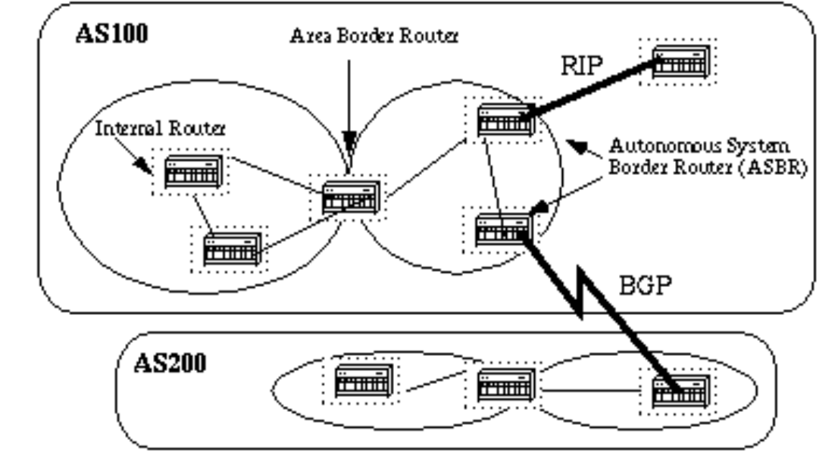
Autonomous System
An autonomous system is a region of the Internet that is administered by a single entity.
Examples of autonomous regions are:
DAIICT organization
Any Internet Service Provider’s network
Routing is done differently within an autonomous system (intradomain routing) and between autonomous system (interdomain routing – Border Gateway Protocol ).

Slide 30
Hierarchical OSPF
two-level hierarchy: local area, backbone.
link-state advertisements flooded only in area, or backbone
each node has detailed area topology; only knows direction to reach other destinations
area border routers: “summarize” distances to destinations in own area, advertise in backbone
boundary router: connects to other ASes
backbone
backbone router: runs OSPF limited to backbone
local routers:
flood LS in area only
compute routing within area
forward packets to outside via area border router
area 3
internal
routers
area 1
area 2

